Slide 1




Spotify Database System CIS 3400 EMWA Group 11
Stephen chan
Steven Du
Jackie Mok
Andrew Ivanov
Denny Huang

Slide 2
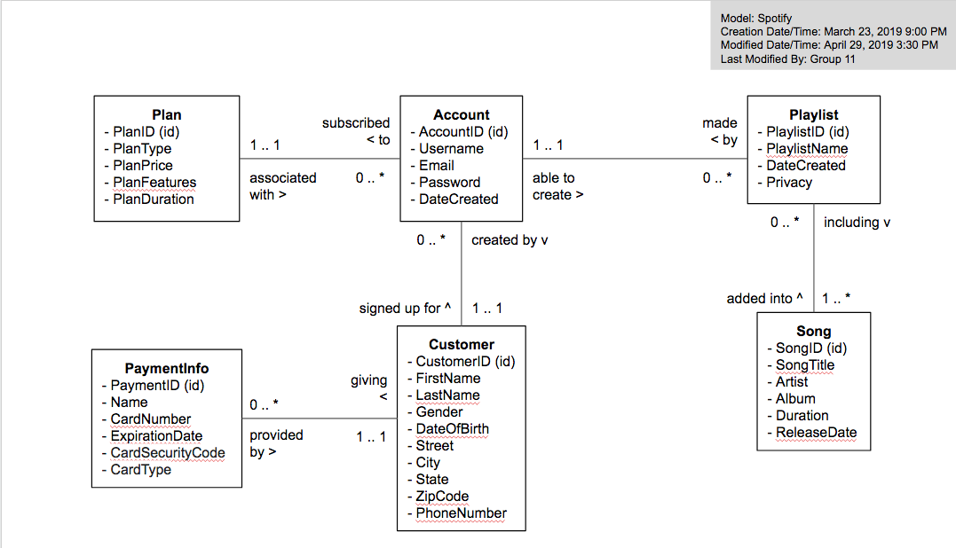
E-R Model

Slide 3
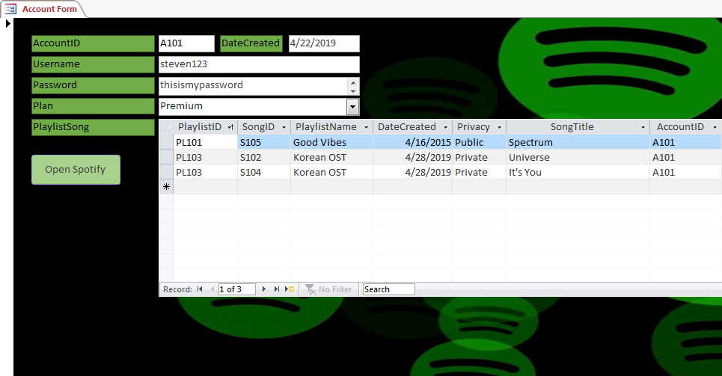
Account Form

